Slide 1
About the Presentations
The presentations cover the objectives found in the opening of each chapter.
All chapter objectives are listed in the beginning of each presentation.
You may customize the presentations to fit your class needs.
Some figures from the chapters are included. A complete set of images from the book can be found on the Instructor Resources disc.

Slide 2
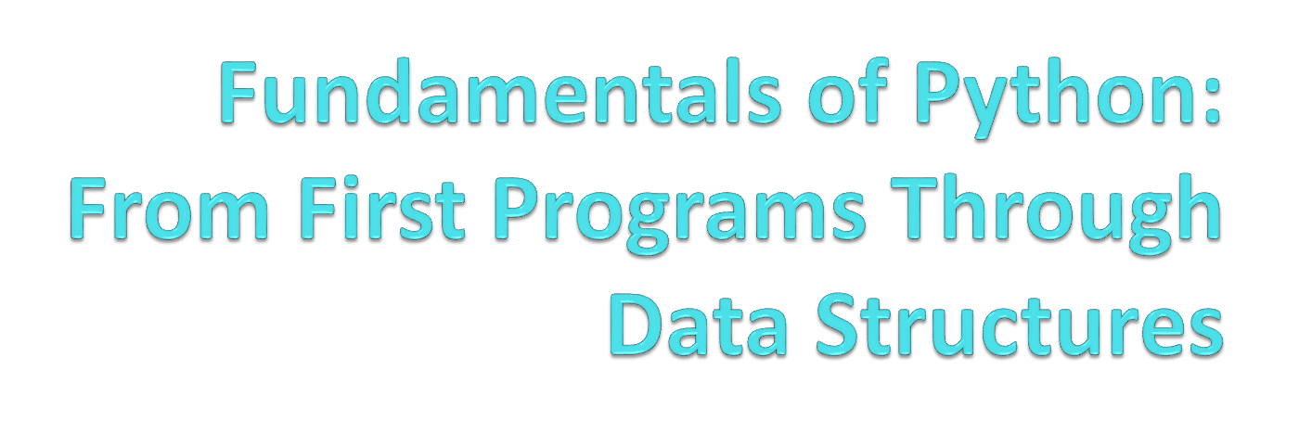
Chapter 1
Introduction

Slide 3
Objectives
After completing this chapter, you will be able to:
Describe the basic features of an algorithm
Explain how hardware and software collaborate in a computer’s architecture
Give a brief history of computing
Compose and run a simple Python program
Fundamentals of Python: From First Programs Through Data Structures

Slide 4
Two Fundamental Ideas of Computer Science: Algorithms and Information Processing
Computer science focuses on a broad set of interrelated ideas
  Two of the most basic ones are:
    Algorithms
    Information processing
Fundamentals of Python: From First Programs Through Data Structures

Slide 5
Algorithms
Steps for subtracting two numbers:
  Step 1: Write down the numbers, with larger number above smaller one, digits column-aligned from right
  Step 2: Start with rightmost column of digits and work your way left through the various columns
  Step 3: Write down difference between the digits in the current column of digits, borrowing a 1 from the top number’s next column to the left if necessary
  Step 4: If there is no next column to the left, stop
    Otherwise, move to column to the left; go to Step 3
The computing agent is a human being
Fundamentals of Python: From First Programs Through Data Structures

Slide 6
Algorithms (continued)
Sequence of steps that describes each of these computational processes is called an algorithm
Features of an algorithm:
  Consists of a finite number of instructions
  Each individual instruction is well defined
  Describes a process that eventually halts after arriving at a solution to a problem
  Solves a general class of problems
Fundamentals of Python: From First Programs Through Data Structures

Slide 7
Information Processing
Information is also commonly referred to as data
In carrying out the instructions of an algorithm, computing agent manipulates information
  Starts with some input and produces an output
The algorithms that describe information processing can also be represented as information
Fundamentals of Python: From First Programs Through Data Structures

Slide 8
The Structure of a Modern Computer System
A modern computer system consists of hardware and software
  Hardware: physical devices required to execute algorithms
  Software: set of these algorithms, represented as programs in particular programming languages
Fundamentals of Python: From First Programs Through Data Structures

Slide 9
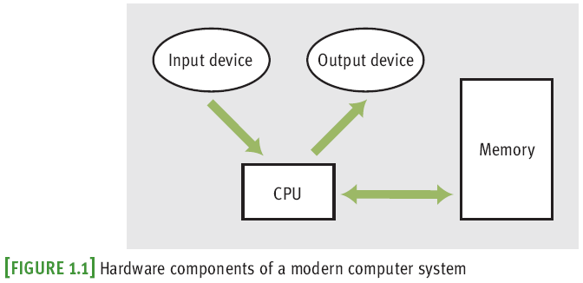
Computer Hardware
Computers can also communicate with the external world through various ports that connect them to networks and to other devices
Fundamentals of Python: From First Programs Through Data Structures

Slide 10
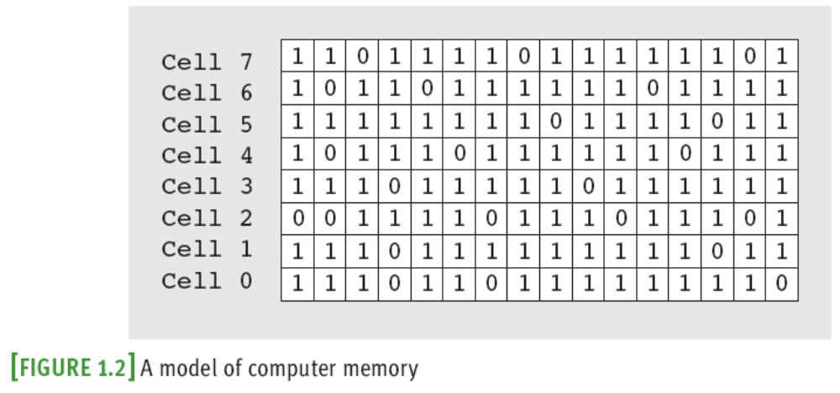
Computer Hardware (continued)
Random access memory (RAM) is also called primary or internal
External or secondary memory can be magnetic, semiconductor, or optical
Fundamentals of Python: From First Programs Through Data Structures

Slide 11
Computer Software
A program stored in computer memory must be represented in binary digits, or machine code
A loader takes a set of machine language instructions as input and loads them into the appropriate memory locations
The most important example of system software is a computer’s operating system
  Some important parts: file system, user interfaces (terminal-based or GUIs)
Applications include Web browsers, games, etc.
Fundamentals of Python: From First Programs Through Data Structures

Slide 12
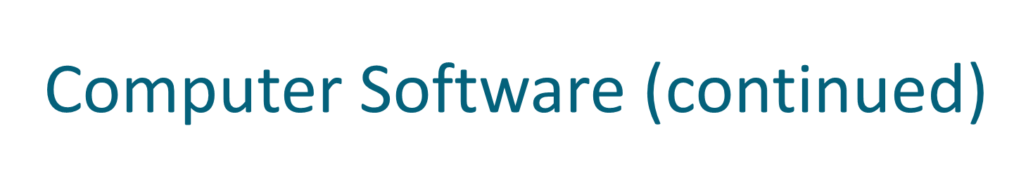
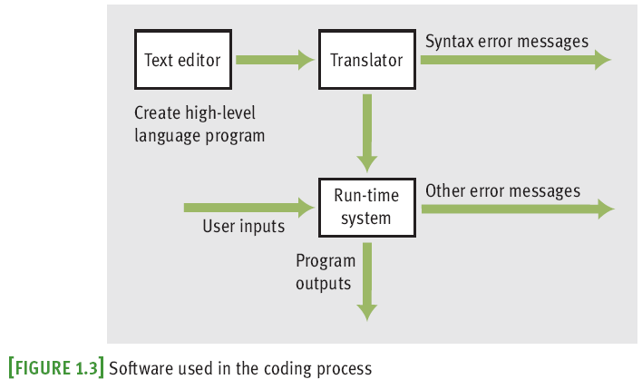
Fundamentals of Python: From First Programs Through Data Structures

Slide 13
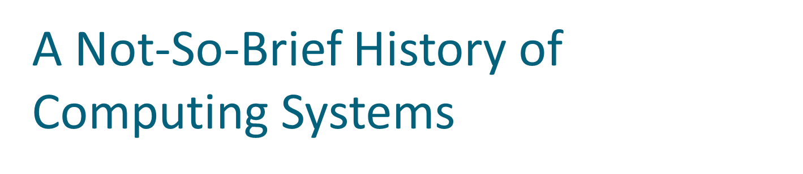
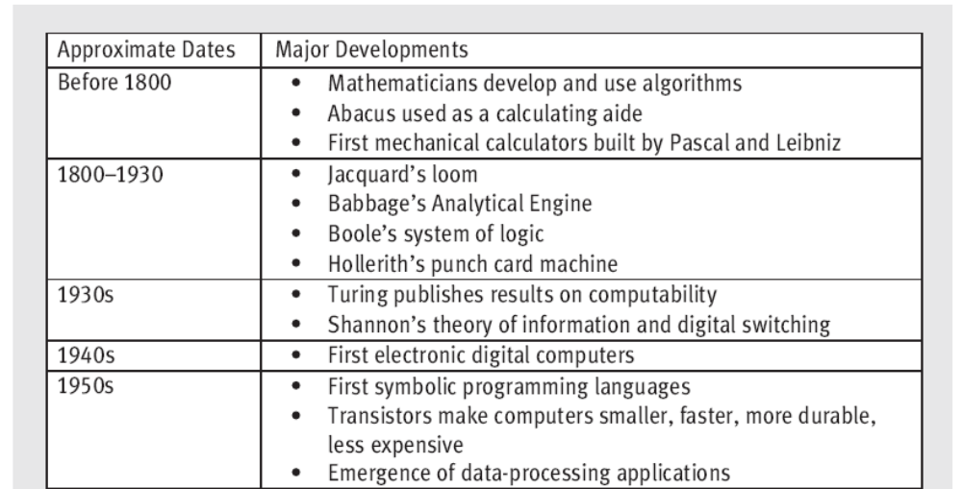
Fundamentals of Python: From First Programs Through Data Structures

Slide 14
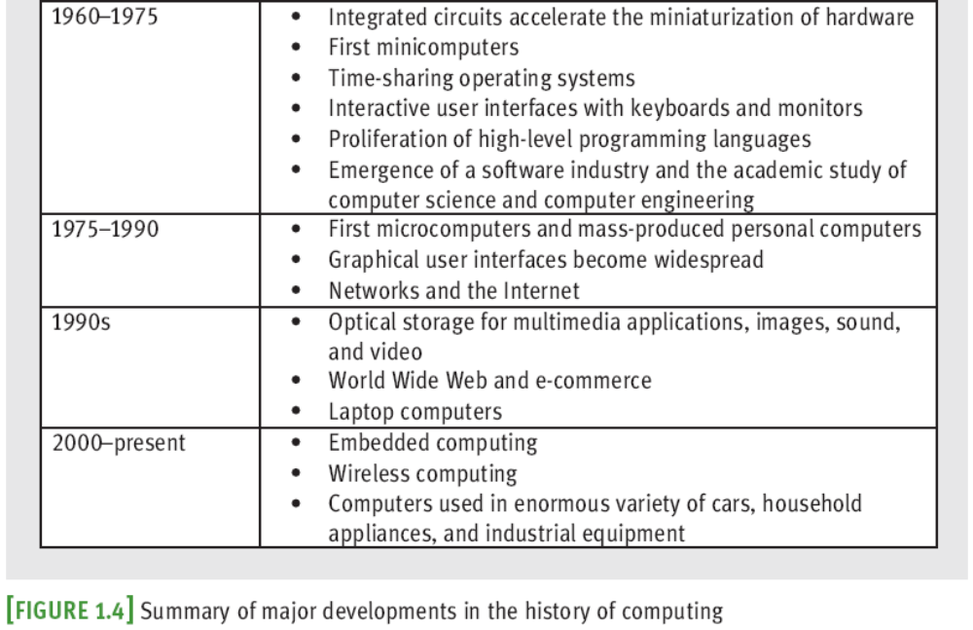
A Not-So-Brief History of
Computing Systems (continued)
Fundamentals of Python: From First Programs Through Data Structures

Slide 15
Before Electronic Digital Computers
“Algorithm” comes from Muhammad ibn Musa Al-Khawarizmi, a Persian mathematician
Euclid developed an algorithm for computing the greatest common divisor of two numbers
The abacus also appeared in ancient times
Blaise Pascal (1623–1662): built one of the first mechanical devices to automate addition
Joseph Jacquard (1752–1834): designed and constructed a machine that automated weaving
Charles Babbage (1792–1871): conceived Analytical Engine
Fundamentals of Python: From First Programs Through Data Structures

Slide 16
Before Electronic Digital Computers (continued)
Herman Hollerith (1860–1929): developed a machine that automated data processing for the U.S. Census
  One of the founders of company that became IBM
George Boole (1815–1864): developed Boolean logic
Alan Turing (1912–1954): explored the theoretical foundations and limits of algorithms and computation
Fundamentals of Python: From First Programs Through Data Structures

Slide 17
The First Electronic Digital Computers (1940–1950)
Late 1930s: Claude Shannon wrote paper titled “A Symbolic Analysis of Relay and Switching Circuits”
1940s:
  Mark I (electromechanical)
  ENIAC (Electronic Numerical Integrator and Calculator)
  ABC (Atanasoff-Berry Computer)
  Colossus by a group working under Alan Turing
  John von Neumann: first memory-stored programs
Mainframe computers, consisted of vacuum tubes, wires, and plugs, and filled entire rooms
Fundamentals of Python: From First Programs Through Data Structures

Slide 18
The First Programming Languages (1950–1965)
The first assembly languages appeared
  Operations like ADD and OUTPUT
Programmers would enter mnemonic codes for operations at keypunch machine
Card reader translated holes in cards to patterns in computer’s memory
Assembler then translated application programs in memory to machine code
High-level programming languages: FORTRAN, LISP, COBOL
  common feature: abstraction
Fundamentals of Python: From First Programs Through Data Structures

Slide 19
Integrated Circuits, Interaction, and Timesharing (1965–1975)
Late 1950s: vacuum tube gave way to transistor
  Transistor is solid-state device
Early 1960s: integrated circuit enabled smaller, faster, less expensive hardware components
  Moore’s Law: processing speed and storage capacity of HW will increase and cost will decrease by approximately a factor of 2 every 18 months
Minicomputers appeared
Processing evolved from batch processing to time-sharing to concurrent
Fundamentals of Python: From First Programs Through Data Structures

Slide 20
Personal Computing and Networks (1975–1990)
Douglas Engelbart
  Late 1960s: First pointing device or mouse
  SW to represent windows, icons, and pull-down menus on a bit-mapped display screen
  Member of team that developed Alto (Xerox PARC)
1975: Altair, first mass-produced personal computer
  With Intel’s 8080 processor, first microcomputer chip
Early 1980s: Gates and Allen build MS-DOS
Bob Metcalfe created Ethernet, used in LANs
ARPANET grew into what we call Internet
Fundamentals of Python: From First Programs Through Data Structures

Slide 21
Consultation, Communication, and Ubiquitous Computing (1990–Present)
Optical storage media developed for mass storage
Virtual reality: capacity to create lifelike 3-D animations of whole-environments
Computing is becoming ubiquitous, yet less visible
Berners-Lee at CERN created WWW
  Based on concepts of hypermedia
  HTTP: Hypertext Transfer Protocol
  HTML: Hypertext Markup Language
Fundamentals of Python: From First Programs Through Data Structures

Slide 22
Getting Started with Python Programming
Guido van Rossum invented the Python programming language in the early 1990s
Python is a high-level, general-purpose programming language for solving problems on modern computer systems
Useful resources at www.python.org
Fundamentals of Python: From First Programs Through Data Structures

Slide 23
Running Code in the Interactive Shell
Python is an interpreted language
Simple Python expressions and statements can be run in the shell
  Easiest way to open a Python shell is to launch the IDLE
  To quit, select the window’s close box or press Control+D
  Shell is useful for:
    Experimenting with short expressions or statements to learn new features of the language
    Consulting the documentation
Fundamentals of Python: From First Programs Through Data Structures

Slide 24
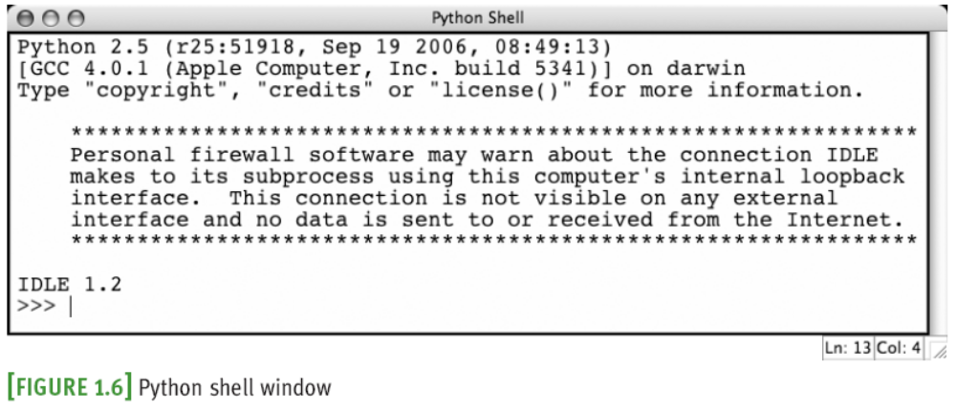
Running Code in the Interactive Shell (continued)
Fundamentals of Python: From First Programs Through Data Structures

Slide 25
Input, Processing, and Output
Programs usually accept inputs from a source, process them, and output results to a destination
  In terminal-based interactive programs, these are the keyboard and terminal display, respectively
Fundamentals of Python: From First Programs Through Data Structures

Slide 26
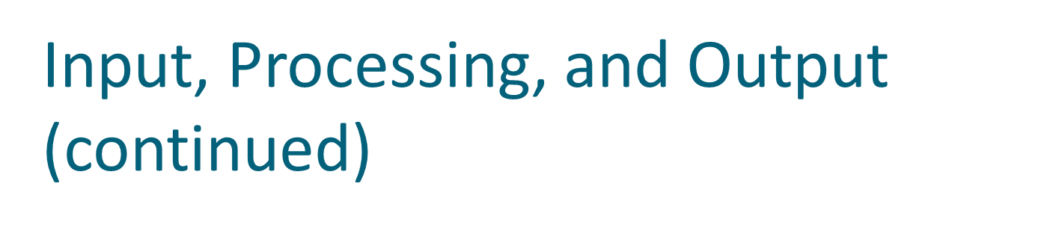
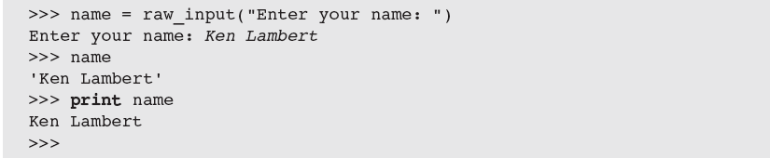
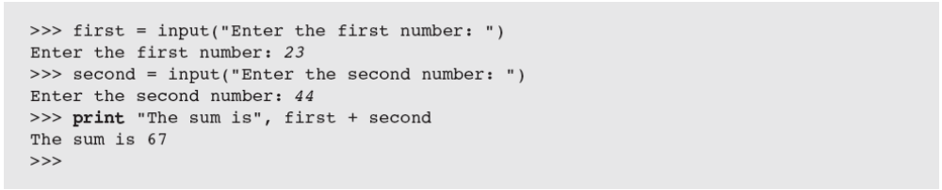
Fundamentals of Python: From First Programs Through Data Structures

Slide 27
Editing, Saving, and Running a Script
We can then run Python program files or scripts within IDLE or from the OS’s command prompt
  Run within IDLE using menu option, F5 (Windows), or Control+F5 (Mac or Linux)
Python program files use .py extension
Running a script from IDLE allows you to construct some complex programs, test them, and save them in program libraries to reuse or share with others
Fundamentals of Python: From First Programs Through Data Structures

Slide 28
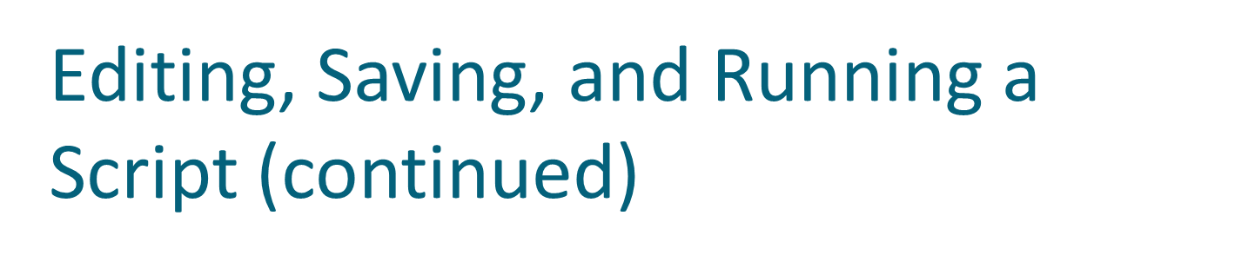
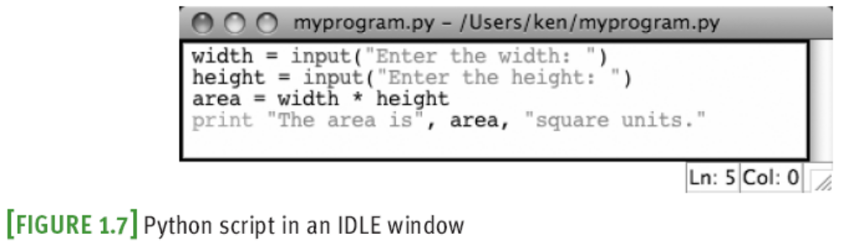
Fundamentals of Python: From First Programs Through Data Structures

Slide 29
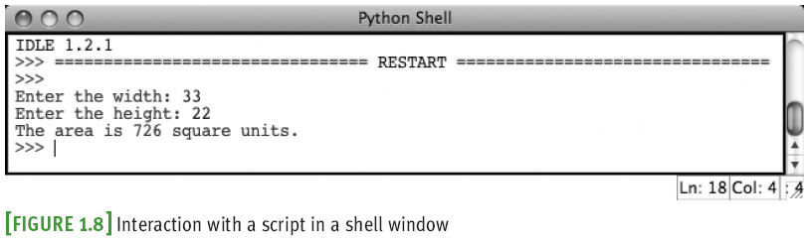
Fundamentals of Python: From First Programs Through Data Structures

Slide 30
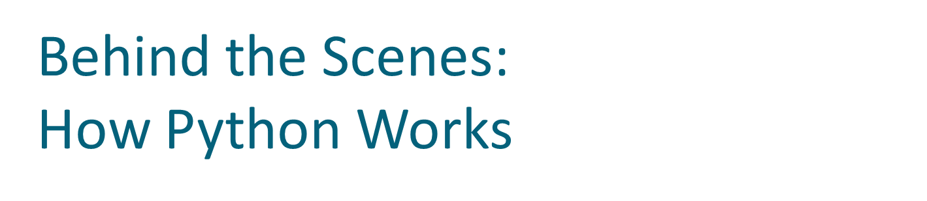
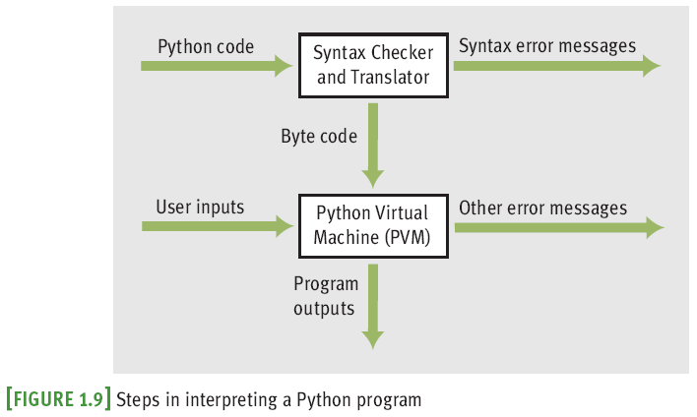
Fundamentals of Python: From First Programs Through Data Structures

Slide 31
Detecting and Correcting Syntax Errors
Programmers inevitably make typographical errors when editing programs
  The Python interpreter will nearly always detect these
  Such errors are called syntax errors
Syntax: rules for forming sentences in a language
When Python encounters a syntax error in a program, it halts execution with an error message
Fundamentals of Python: From First Programs Through Data Structures

Slide 32
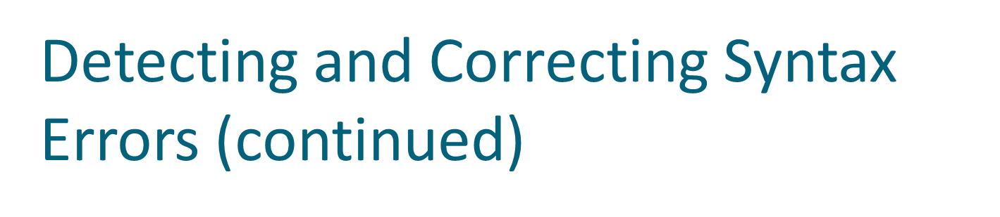
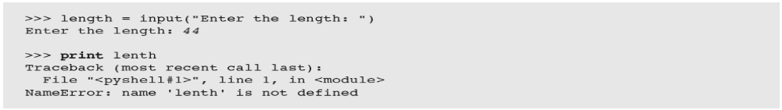
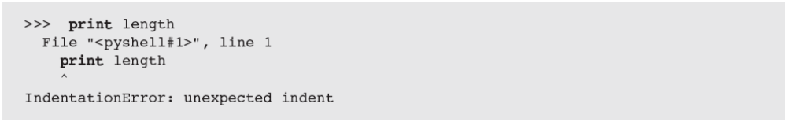
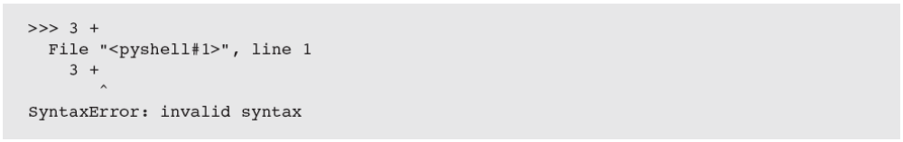
Fundamentals of Python: From First Programs Through Data Structures

Slide 33
Summary
Fundamental ideas of computer science
  The algorithm
  Information processing
Real computing agents can be constructed out of hardware devices
  CPU, memory, and input and output devices
Some real computers are specialized for a small set of tasks, whereas a desktop or laptop computer is a general-purpose problem-solving machine
Fundamentals of Python: From First Programs Through Data Structures

Slide 34
Summary (continued)
Software provides the means whereby different algorithms can be run on a general-purpose hardware device
  Written in programming languages
Languages such as Python are high-level
Interpreter translates a Python program to a lower-level form that can be executed on a real computer
Python shell provides a command prompt for evaluating and viewing the results of Python expressions and statements
Fundamentals of Python: From First Programs Through Data Structures

Slide 35
Summary (continued)
IDLE is an integrated development environment that allows the programmer to save programs in files and load them into a shell for testing
Python scripts are programs that are saved in files and run from a terminal command prompt
When a Python program is executed, it is translated into byte code
  Sent to PVM for further interpretation and execution
Syntax: set of rules for forming correct expressions and statements in a programming language
Fundamentals of Python: From First Programs Through Data Structures

